Slide 1
AERODYNAMICS
د. محمد خضير عباس

Slide 2
Chap.3
Fundamentals of Inviscid, Incompressible Flow

Slide 3
OUTLINE
Bernoulli’s equation and its application
Pressure coefficient
Laplace’s equation for irrotational, incompressible flow
Elementary flows
Combination of elementary flows

Slide 4
Bernoulli’s equation and its application
Bernoulli’s equation
Relation between pressure and velocity in an inviscid, incompressible flow.
Equation form along a streamline
If the flow is irrotational,
throughout the flow

Slide 5
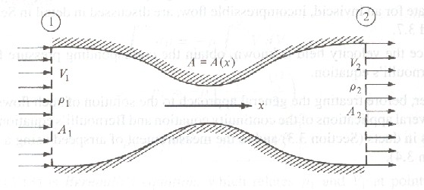
Flow in a duct
Continuity equation for quasi-one-dimensional flow in a duct
For incompressible flow

Slide 6
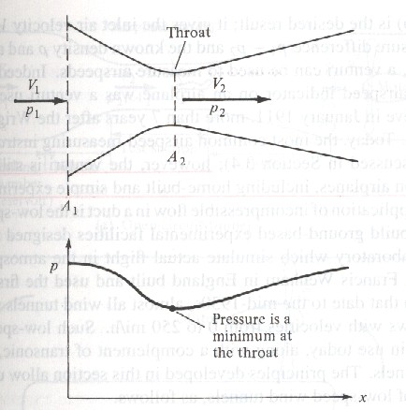
The venturi and low-speed wind tunnel
In aerodynamic application, venturi can be used to measure the velocity of inlet flow V1.
From Bernoulli’s equation:

Slide 7
A low-speed wind tunnel is a large venturi where the airflow is driven by a fan.
The test section flow velocity can be derived from Bernoulli’s equation

Slide 8
Pitto tube
Stagnation point: a point in a flow where V = 0. (ex. Point B in the figure.)
Stagnation pressure p0: pressure at a stagnation point, also called total pressure.
To measure the flight velocity of an airplane.

Slide 9
Pressure coefficient
Pressure coefficient is defined as
where
For incompressible flow
Cp can be reduced to be in terms of velocity only.

Slide 10
Laplace’s equation for irrotational, incompressible flow
For incompressible flow
For irrotational flow (ϕ is velocity potential)
Laplace’s equation
The stream function ψ also satisfies Laplace’s equation.

Slide 11
Solution of Laplace’s equation
Solutions of Laplace’s equation are called harmonic functions.
Superposition principle is applicable since Laplace’s equation is linear.
A complicated flow pattern can be synthesized by adding together a number of elementary flows.

Slide 12
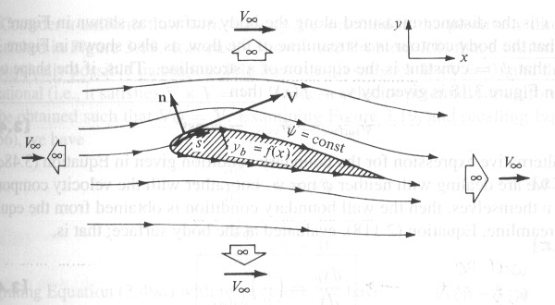
Boundary contions
Infinity boundary conditions
Wall boundary conditions (wall tangency conditions)

Slide 13
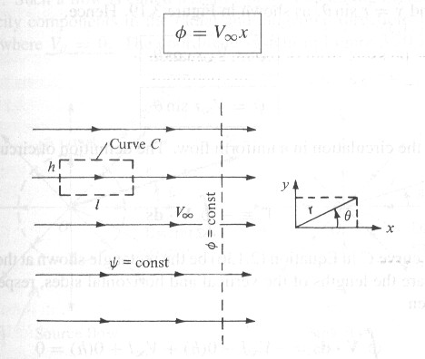
Elementary flows
Uniform flow
A uniform flow is a physically possible incompressible and irrotational flow.
Boundary condition for ϕ
Solution for ϕ

Slide 14
Boundary condition for ψ
Solution for ψ

Slide 15
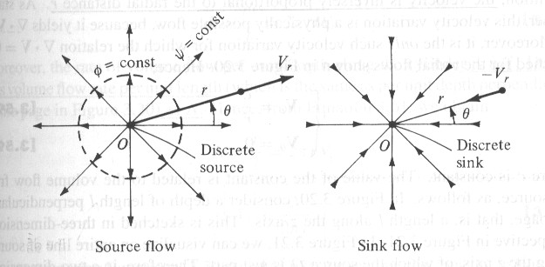
Source flow
Cylindrical coordinate system is applied.
Incompressible at every point except the origin.
Irrotational at every point.
Velocity field
where Λ is the source strength, defined as the volume flow rate per unit length.

Slide 16
Λ is positive for a source flow, whereas negative for a sink flow.
Solution for ϕ and ψ

Slide 17
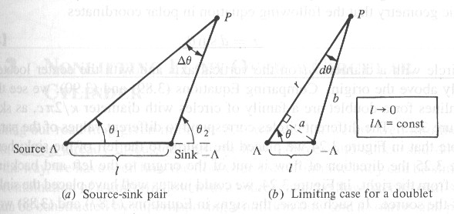
Doublet flow
A pair of source-sink with the same strength, while the distance l between each other tends to zero.
Stream function ψ
where κ=const. is the strength of the doublet.

Slide 18
Solution for ϕ and ψ
The direction of a doublet is designated by an arrow draw form the sink to the source.

Slide 19
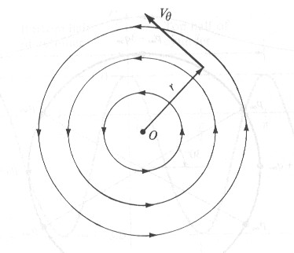
Vortex flow
A flow where all the streamlines are concentric circles, and the velocity along any circular streamline is constant.
Incompressible at every point.
Irrotational at every point except the origin.

Slide 20
Velocity field
where Γ is the circulation.
Solution for ϕ and ψ

Slide 21
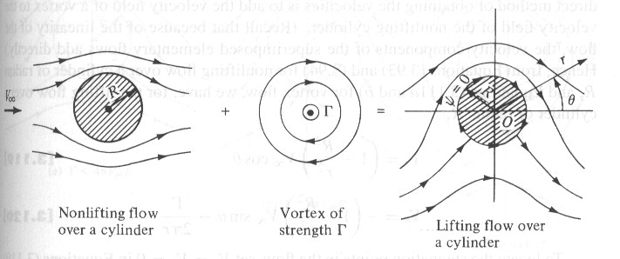
Combination of elementary flows
Superposition of a uniform flow and a source
Stream function ψ

Slide 22
Velocity field
Stagnation point
The streamline goes through the stagnation point is described by ψ=Λ/2, shown as curve ABC .

Slide 23
Streamline ABC separates the fluid coming from the free stream and the fluid emanating from the source.
The entire region inside ABC could be replaced with a solid body of the same shape.

Slide 24
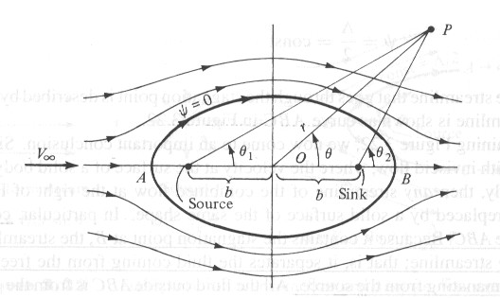
Superposition of a uniform flow and a source-sink pair
Stream function ψ

Slide 25
Two stagnation points A and B are found by setting V=0.
The stagnation streamline is given by ψ=0, i.e.
which is the equation of an oval, called Rankine oval.
The region inside the oval can be replaced by a solid body with the same shape.

Slide 26
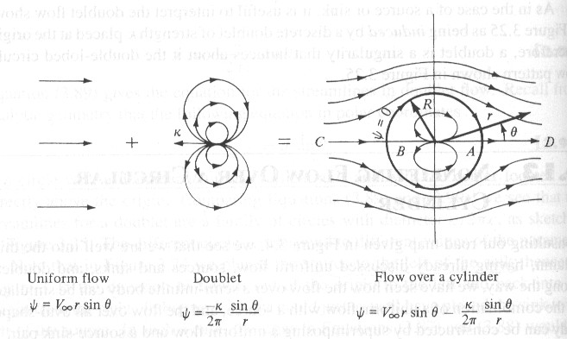
Nonlifting flow over a circular cylinder
Superposition of a uniform flow and a doublet
Stream function ψ

Slide 27
Velocity field
The stagnation streamline is given by ψ=0, i.e.
The stagnation streamline includes the circle described by r=R, and the entire horizontal axis through points A and B.

Slide 28
We can replace the flow inside the circle by a solid body. Consequently, a flow over a circular cylindrical of radius R can be synthesized by this superposition, where
The pressure distribution is symmetric about both axes. As a result, there is no net lift, as well as no net drag which makes no sense in real world.

Slide 29
Define span efficiency factor e
Note that δ=0 and e=1 for the elliptical lift distribution. Hence, the lift distribution which yields minimum induced drag is the elliptical lift distribution.

